Slide 1
MICROPROCESSORS
BY
ROSHAN FERNANDES
ASST. PROF.
DEPT OF CSE
NMAMIT, NITTE

Slide 2
Overview of Microcomputer Structure and Operation

Slide 3
Major parts are the CPU, Memory and the Input and Output circuitry or I/O
Connecting these parts are three sets of parallel lines called buses
Address bus, Data Bus and Control Bus

Slide 4
DATA BUS
INPUT
DEVICE
I/O
PORTS
CONTROL
BUS
CPU
CONTROL
BUS
MEMORY
(RAM AND
ROM)
OUTPUT
DEVICE
ADDRESS BUS
Block Diagram of a simple Microcomputer

Slide 5
Memory
Memory unit is the integral part of any microcomputer system and its primary purpose is to hold program and data
The major design goal of memory unit is to allow it to operate at a speed close to that of the processor
In order to seek a trade-off between the cost and operating speed, a memory system is usually designed with different technologies such as solid state, magnetic and optical

Slide 6
A Microcomputer memory can be logically divided into three groups:
  Processor Memory
  Primary or Main Memory
  Secondary memory
Processor Memory refers to a set of CPU registers
These registers are useful to hold temporary results when a computation is in progress

Slide 7
There is no speed disparity between the registers and the microprocessor because they are fabricated using the same technology
The main disadvantage is the cost involved which forces the architect to include very few registers (usually 8 to 16 only) in the microprocessor

Slide 8
Primary Memory:
Is the storage area in which all the programs are executed
The processor can directly access only those items that are stored in the primary memory
All the programs and corresponding data must be within primary memory prior to execution
The size of primary memory is much larger compared to processor memory but its operating speed is slower than processor registers

Slide 9
Primary memory normally includes ROM (Read Only Memory) and RAM (Random Access Memory)

Slide 10
Secondary memory
Refers to the storage medium for huge files such as program source codes, compilers, operating systems, RDBMSs etc
These are not needed very frequently
They comprises of slow devices such as magnetic tapes and optical disks

Slide 11
Input/Output
Allows the computer to take in data from the outside world or send data to the outside world
Peripherals such as keyboards, video display terminals, printers and modems are connected to the I/O section
The actual physical devices used to interface the computer buses to external systems are called ports

Slide 12
An input port allows data from a keyboard, an A/D converter, or some other source to be read into the computer under the control of CPU
An output port is used to send data from the computer to some peripheral, such as a video display terminal, a printer etc

Slide 13
Central Processing Unit (CPU)
Controls the operation of the computer
Fetches binary-coded instructions from memory, decodes the instructions into a series of simple actions and carries out these actions in a sequence of steps
Also contains Address Counter or Instruction Pointer register

Slide 14
Address Bus
Consists of 16, 20, 24 or 32 parallel signal lines
On these lines the CPU sends out the address of the memory location that is to be written or read from
The number of unique addresses a microprocessor can generate depends on the width of this bus

Slide 15
16 – bits address bus - it can generate 2¹⁶ = 65,536 different addresses
Unidirectional – from microprocessor to memory or I/O elements

Slide 16
Data Bus
Consists of 8, 16 or 32 parallel signal lines
Bidirectional – data is brought on these lines prior to an operation and results are sent back to selected memory location or I/O using these lines only
The width determines the amount of information that can be brought/sent at once, more precisely in one machine cycle into or out of processor

Slide 17
Control Bus
Consists of 4 to 10 signal lines
CPU sends out signals on the control bus to enable the outputs of addressed memory devices or port devices
Typical control bus signals are Memory Read, Memory Write, I/O Read, and I/O Write
Some signals are unidirectional and some are bidirectional

Slide 18
The memory read signal enables the addressed memory device to output a data word onto the data bus
The data word from the memory travels along the data bus to the CPU

Slide 19
Hardware, Software, and Firmware
Hardware is the name given to the physical devices and circuitry of the computer
Software refers to the programs written for the computer
Firmware is the term given to programs stored in ROMs or in other devices which permanently keep their stored information

Slide 20
EVOLUTION
OF
MICROPROCESSORS

Slide 21
First generation (1971 – 73)
Intel Corporation introduced 4004, the first microprocessor in 1971. It is evolved from the development effort while designing a calculator chip
There were three other microprocessors in the market during the same period:
  Rockwell International’s PPS-4 (4 bits)
  Intel’s 8008 (8 bits)
  National Semiconductor’s IMP-16 (16 bits)

Slide 22
They were fabricated using PMOS technology which provided low cost, slow speed and low output currents
They were not compatible with TTL

Slide 23
Second Generation (1974 – 1978)
Marked the beginning of very efficient 8 – bit microprocessors
Some of the popular processors were:
  Motorola’s 6800 and 6809
  Intel’s 8085
  Zilog’s Z80
They were manufactured using NMOS technology
This technology offered faster speed and higher density than PMOS
It is TTL compatible

Slide 24
Third generation microprocessors (1979 – 80)
This age is dominated by 16 – bits microprocessors
Some of them were:
  Intel’s 8086/80186/80286
  Motorolla’s 68000/68010
They were designed using HMOS technology
HMOS provides some advantages over NMOS as
Speed-power-product of HMOS is four times better than that of NMOS
HMOS can accommodate twice the circuit density compared to NMOS

Slide 25
Fourth Generation (1981 – 1995)
This era marked the beginning of 32 bits microprocessors
Intel introduced 432, which was bit problematic
Then a clean 80386 in launched
Motorola introduced 68020/68030.
They were fabricated using low-power version of the HMOS technology called HCMOS

Slide 26
Fifth Generation (1995 – till date)
This age the emphasis is on introducing chips that carry on-chip functionalities and improvements in the speed of memory and I/O devices along with introduction of 64-bit microprocessors.

Slide 27
Architecture of 8086

Slide 28
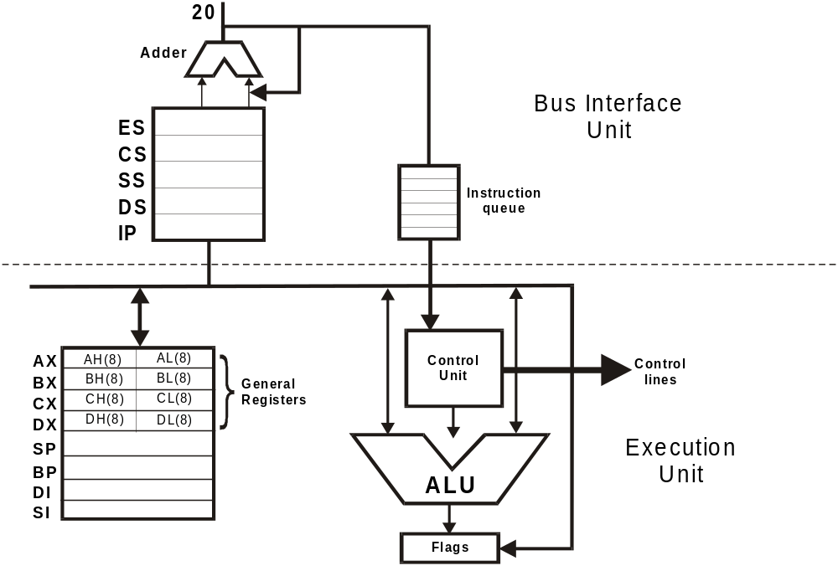

Slide 29
Execution Unit
The execution unit consists of
  General Registers
  Arithmetic Logic Unit
  Control unit
  Flag Registers

Slide 30
General Registers
The CPU has eight 16-bit general registers
They are divided into two files of four registers each
They are:
(a) The data register file and
(b) The pointer and index register file

Slide 31
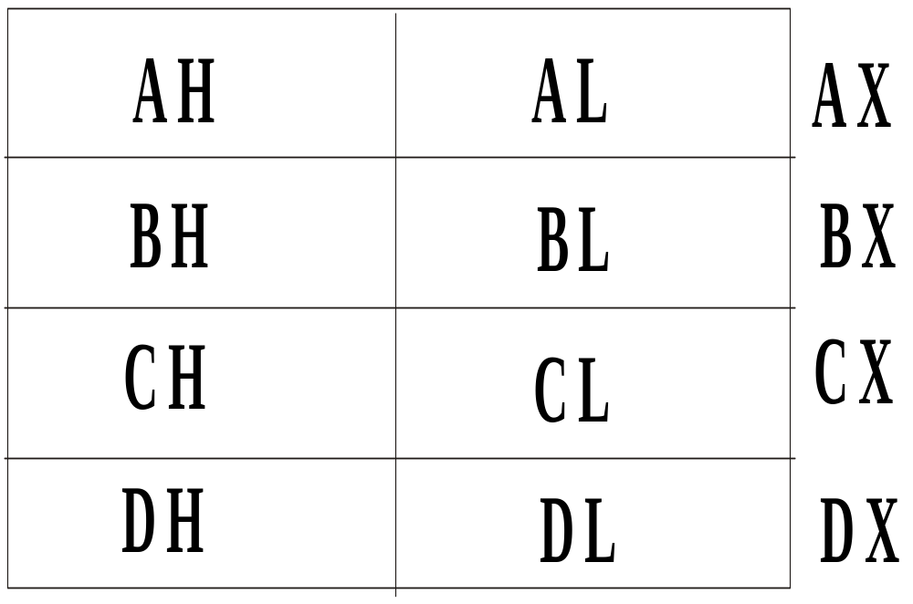
Data Register File

Slide 32
The upper and lower halves of the data registers are individually addressable
The data registers can be used in most arithmetic and logic operations
Some instructions however require these registers for specific use

Slide 33
The index register file consists of the Stack Pointer (SP), the Base Pointer (BP), Source Index (SI) and Destination Index (DI) registers all are of 16-bits
These registers are usually used to hold offset addresses for addressing within a segment
Offset addressing reduces program size by eliminating the need for each instruction to specify frequently used addresses

Slide 34
The pointer and index register files are further divided into the pointer sub-file (containing the Stack Pointer and the Base Pointer registers) and the index sub-file (containing the Source index and Destination index registers)
Unless otherwise specified in the instruction, stack pointer registers refer to the current stack segment while index register refers to the current data segment

Slide 35
8086 has an additional pointer into the stack called the BP register
the BP register is used to hold an old stack pointer value, or it can mark a place in the subroutine stack independent of the SP register
SI and DI are both 16-bits wide and are used by string manipulation instructions and in building some of the more powerful 8086/8088 data structures and addressing modes

Slide 36
Both the SI and the DI registers have auto incrementing and auto-decrementing capabilities

Slide 37
Arithmetic Logic Unit (ALU)
ALU is 16-bits wide. It can do the following 16-bits arithmetic operations
    Addition
    Subtraction
    Multiplication
    Division
Arithmetic operations may be performed on four types of numbers
    Unsigned binary numbers
    Signed binary numbers (Integers)
    Unsigned packed decimal numbers
    Unsigned unpacked decimal numbers

Slide 38
The ALU can also perform logical operations such as
    NOT
    AND
    OR
    EXCLUSIVE OR
    TEST

Slide 39
Flag Register
The Execution Unit has a 16-bit flag register which indicates some conditions affected by the execution of an instruction
Some bits of the flag register control certain operations of the EU

Slide 40
15 | 14 | 13 | 12 | 11 | 10 | 9 | 8 | 7 | 6 | 5 | 4 | 3 | 2 | 1 | 0
U | U | U | U | OF | DF | IF | TF | SF | ZF | U | AF | U | PF | U | CF

Slide 41
Six of the nine flags are used to indicate some condition produced by an instruction
These condition flags are also called status flags of 8086 microprocessor
These are the Carry flag, Parity flag, Auxiliary carry flag, Zero flag, and Sign flag
The other three Control flags are Trap Flag, Direction Flag and Interrupt flag

Slide 42
Carry Flag (CF)
This flag will be set to one if the addition of two 16-bit binary numbers produces a carry out of the most significant bit position or if there is a borrow to the MSB after subtraction
This flag is also affected when other arithmetic and logical instruction are executed

Slide 43
Parity Flag (PF)
This flag is set, if the result of the operation has an even number of 1's (in the lower 8 bits of the result)
This flag can be used to check for data transmission error

Slide 44
Auxiliary Carry Flag (AF)
This flag is set, when there is a carry out of the lower nibble to the higher nibble or a borrow from the higher nibble to the lower
The auxiliary carry flag is used for decimal adjust operation

Slide 45
Zero Flag (Z)
This flag is set when the result of an operation is zero
The flag is reset when the result is not zero

Slide 46
Overflow Flag (O)
This flag is set, when an arithmetic overflow occurs
Overflow means that the size of the result exceeded the storage capacity of the destination, and a significant digit has been lost

Slide 47
Sign flag (S)
This flag is set, when an MSB bit of the result is high after an arithmetic operation
When this flag is set the data is assumed to be negative and when this flag is zero it is assumed to be positive

Slide 48
Control Flags
Control flags are used to control certain operations of the processor
The application of these flags are different from that of six conditional flags
The conditional flags are set or reset by the EU on the basis of the result of some arithmetic or logic operations
The control flags are deliberately set or reset with specific instructions included in the program

Slide 49
Trap flag (T)
This is used for single stepping through a program
It is used for debugging the programs

Slide 50
Interrupt Flag (I)
It is used to allow / prohibit the interruption of a program
When the flag set, it enables the interrupt from INTR
When the flag is reset (0), it disables the interrupt

Slide 51
Direction Flag (D)
It is used for string instruction
If the direction flag is set, the pointers are decremented else the pointers are incremented

Slide 52
Bus Interface Unit (BIU)
The BIU sends out addresses, fetches instructions from memory, reads data from memory and ports, and writes data to ports and memory
BIU handles all transfers of data and addresses on the buses for the execution unit
The BIU has
1. An instruction queue
2. An Instruction pointer
3. Segment registers

Slide 53
Instruction Queue
To speed up program execution, the BIU fetches as many as 6 instruction bytes ahead of time from memory
The prefetched instruction bytes are held for the EU in a first-in-first-out group of register called a queue
When the EU is ready for its next instruction, it simply reads the instruction from the queue in the BIU

Slide 54
Fetching the next instruction while the current instruction executes, is called pipelining

Slide 55
Segment Registers
The 8086 microprocessor has 20-bit address lines
All the segment registers in 8086 are 16-bits in length
A segment is a logical unit of memory that may be up to 64K bytes long

Slide 56
Each segment is made up of contiguous memory locations and is an independent, separately addressable unit
Each segment is assigned a base address, which is its starting location in the memory space
All segments start on 16-bit memory boundaries

Slide 57
A segment register is used to hold the upper 16 bits of the starting address for each of the segments
The BIU always inserts zeros for the lowest 4 bits (nibble) of the 20-bit starting address for a segment
If the code segment register contains 348Ah, then the code segment will start at address 348A0h

Slide 58
FFFFFH
HIGHEST ADDRESS
7FFFFH
Top of Extra Segment
64k
70000H
Extra Segment Base ES = 7000H
5FFFFH
Top of Stack Segment
64k
50000H
Stack Segment Base SS = 5000h
4489FH
Top of Code Segment
64k
348A0H
Code Segment Base CS = 348Ah
2FFFFH
Top of Data Segment
64k
20000H
Bottom of Data Segment

Slide 59
Given that the EA is 2359 H and the DS = 490B H, what is the physical address?
DS: 490B0 H
EA: 2359 H
Physical add. 4B409

Slide 60
Instruction Pointer (IP)
The Instruction Pointer is a 16-bit register
The instruction pointer is incremented after each opcode fetch to point to the next instruction
The value contained in the IP is referred to as an offset because this value must be offset from (added to) the segment base address in CS to produce the required 20-bit physical address sent out by the BIU

Slide 61
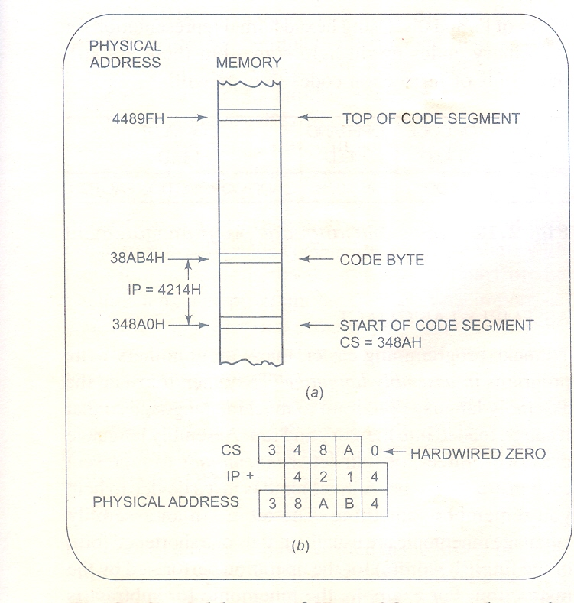

Slide 62
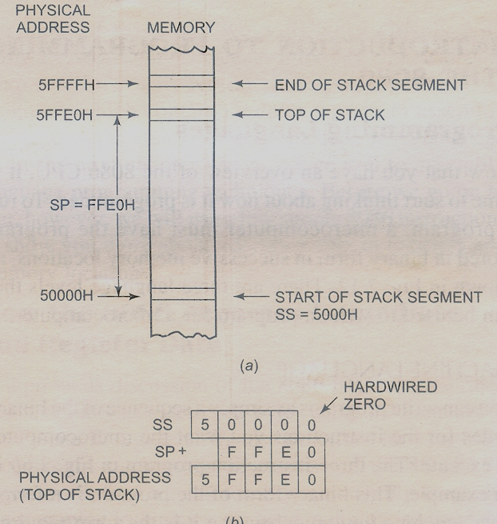

Slide 63
Thank You..

